Slide 1
Visitor pattern
Group 11

Slide 2
Overview
Used to manage algorithms, relationships and responsibilities between objects.
Follows the open/closed design principle
Visitors implement a visit() method Visitables implement an accept() method

Slide 3
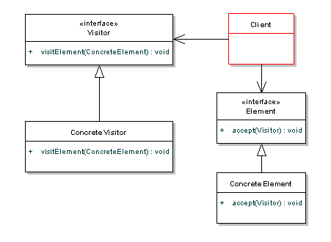
UML Example
Source: java.dzone.com
Notes:
The core of this pattern is the Visitor interface. This interface defines a visit operation for each type of ConcreteElement in the object structure. Meanwhile, the ConcreteVisitor implements the operations defined in the Visitor interface. The concrete visitor will store local state, typically as it traverses the set of elements. The element interface simply defines an accept method to allow the visitor to run some action over that element - the ConcreteElement will implement this accept method.

Slide 4
When to use Visitor pattern?
When you have distinct and unrelated operations to perform across a structure of objects.
If you want to decouple some logical code from the elements that you’re using as input.
Notes:
The pattern should be used when you have distinct and unrelated operations to perform across a structure of objects. This avoids adding in code throughout your object structure that is better kept seperate, so it encourages cleaner code. You may want to run operations against a set of objects with different interfaces. Visitors are also valuable if you have to perform a number of unrelated operations across the classes.
In summary, if you want to decouple some logical code from the elements that you're using as input, visitor is probably the best pattern for the job.

Slide 5
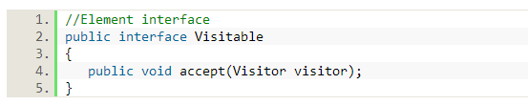
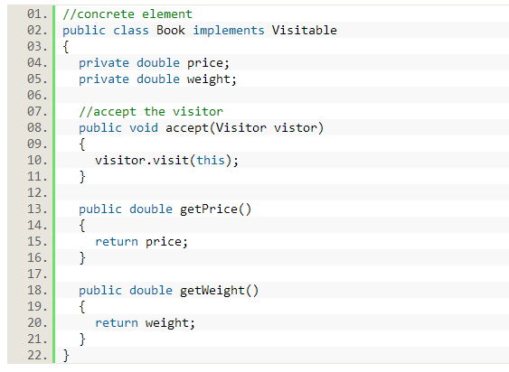
Java Example (Element)
Notes:
The accept method added to allow the visitor to access the element. We could add in other types here to handle other items such as CDs, DVDs, or games.

Slide 6
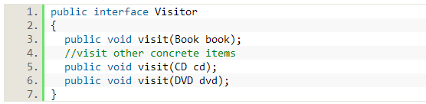
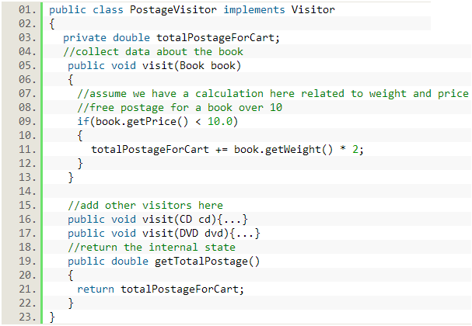
Java Example (Visitor)
Add a new visit method for each concrete visitable element.
Notes:
For each concrete element, we need to add a visit method.

Slide 7
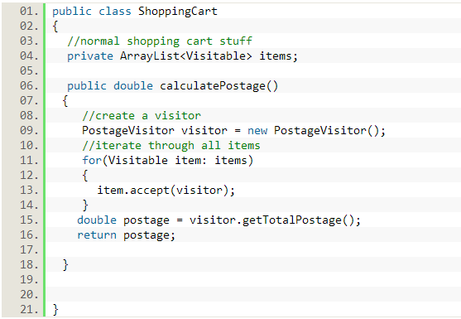
Java Example (Implementation)

Slide 8
Real World Example
Customer and Taxi: User calls a taxi, taxi arrives at user’s door. Once the user sits in taxi, the visiting taxi is in control of transporting that person.
Supermarket checkout: When you go to the checkout, cashier acts as visitor. Some elements can be directly scanned for price, others must be weighed to get the price.

Slide 9
Sources
http://en.wikipedia.org/wiki/Visitor_pattern
http://www.oodesign.com/visitor-pattern.html
http://java.dzone.com/articles/design-patterns-visitor

